Slide 1
Methods 2 Classroom 10

Slide 2
TODAY
Implementing the analytical OLS solution in R
Linear regression using bayesian inference on GPA and household income data (inspired from exercise 9.1 in ROS)
Optional: catching up on optimization from last week

Slide 3
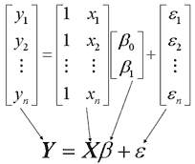
The Linear model on Matrix form
Try to compute the vector and matrix multiplications and additions as we have learned in previous weeks if this is hard to grasp ;)

Slide 4
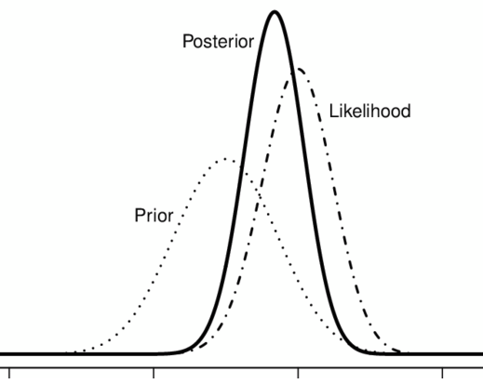
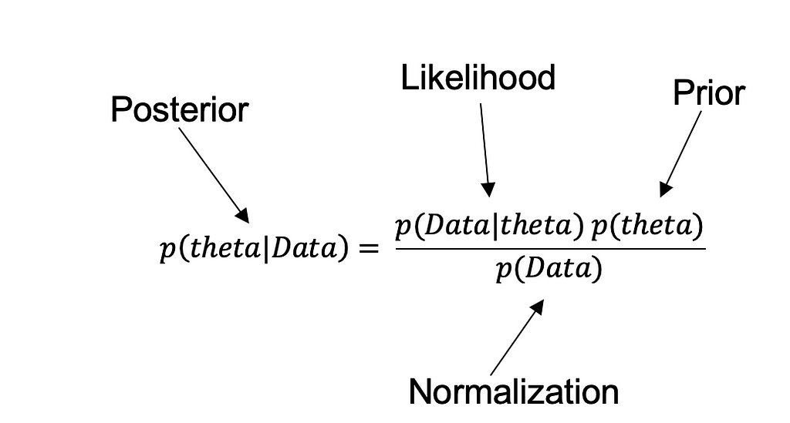
Bayesian Inference
Remember theta is the general term for model parameters, which in the case of the linear model are the betas

Slide 5
LM() vs. Stan_GLM
LM
Uses classical least squares and returns estimates and standard errors.
STAN_GLM
Performs bayesian inference and returns estimates, standard errors and posterior distributions.
Useful for visualizing uncertainty
Prior information can be incorporated
- For simple problems with no prior the LM and STAN_GLM will yield the same results

Slide 6





Predictions & Uncertainty
Point prediction:
- Based on the fitted model and it uses the estimates for and
- Point prediction completely ignores uncertainty
- Implemented using predict() in R
Linear predictor :
- Propagates the inferential uncertainty of and
- It represents the distribution of uncertainty about the mean value of y
- Implemented as posterior_linpred() in R (using rstanarm)
Predictive distribution :
- Uncertainty about an observation of y
- Implemented as posterior_predict() in R (using rstanarm)

Slide 7
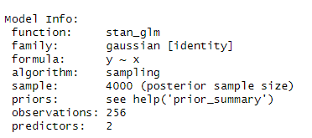
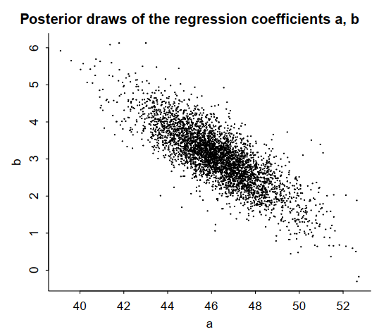
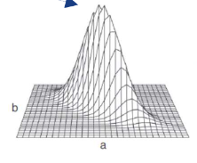
Stan_GLM: sampling
STAN_GLM per default uses sampling
LM uses optimization with RSS as loss function (last week)

Slide 8
Exercises
Exercises in the notebook (inspired from ROS 9.1)
Optional finish up exercises from last week
Link to the exercise notebook: https://classroom.github.com/a/rkMfGzMa

